Slide 1
Brute force knapsack

Slide 2
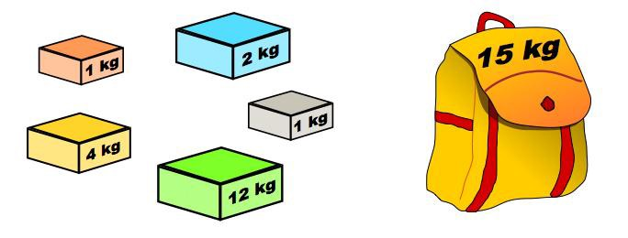
Introduction
The knapsack problem is a problem in combinatorial optimization:
Given a set of items, each with a weight and a value, determine the number of each item to include in a collection, so that the total weight is less than or equal to a given limit and the total value is as large as possible

Slide 3
We have n items – 2^n possible combinations
With Weights – w1, w2, w3,…….wn
The value for each item is specified as – V1, V2, V3,…..Vn
Using Brute force method – Find the Most Valuable Subset
That is the most valuable subset that can fit into the Knapsack is the solution for brute force approach for the Knapsack problem.

Slide 4
Knapsack Capacity is specified as 10
ITEM | ITEM WEIGHT | ITEM VALUE
1 | 5 | $20
2 | 3 | $40
3 | 4 | $30

Slide 5
Solution – Brute Force
First Compute the different combinations
Combination of items | Weight < = Knapsack Capacity | Total Value from Knapsack
1 | 5 | $20
2 | 3 | $40
3 | 4 | $30
1,2 | 5+3=8 | 20+40=$60
1,3 | 5+4=9 | 20+30=$50
2,3 | 3+4=7 | 40+30=$70
1,2,3 | 5+3+4=12 | Not applicable

Slide 6

Psuedocode

Slide 7
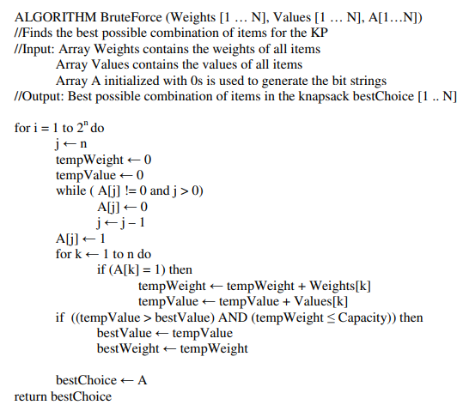

Slide 8
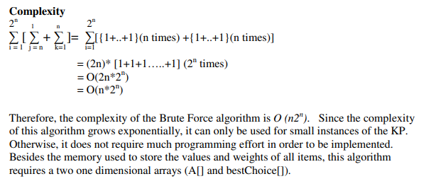
Complexity

Slide 9
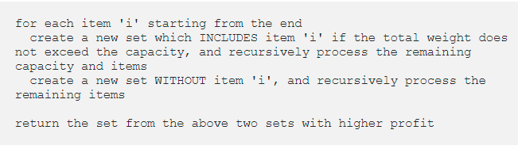
Pseudocode 2

Slide 10
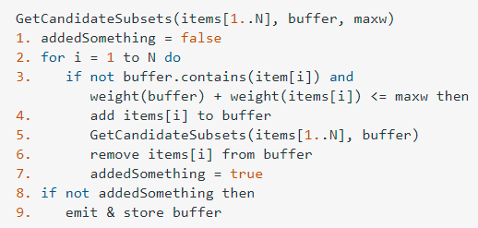
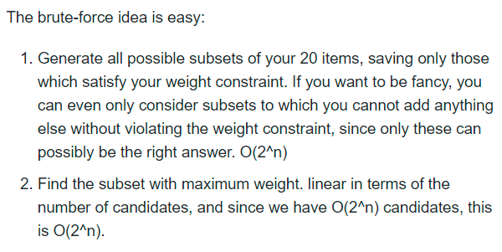
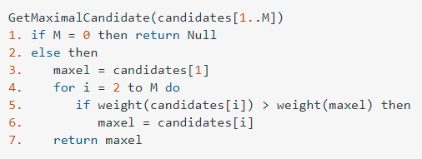
Pseudocode 3

Slide 11
References
https://www.gatevidyalay.com/0-1-knapsack-problem-using-dynamic-programming-approach/

Slide 12
A thief enters a house for robbing it. He can carry a maximal weight of 5 kg into his bag. There are 4 items in the house with the following weights and values. What items should thief take if he either takes the item completely or leaves it completely?
A thief enters a house for robbing it. He can carry a maximal weight of 5 kg into his bag. There are 4 items in the house with the following weights and values. What items should thief take if he either takes the item completely or leaves it completely?
Item | Weight (kg) | Value ($)
Mirror | 2 | 3
Silver nugget | 3 | 4
Painting | 4 | 5
Vase | 5 | 6

